Slide 1

VEHICLE FUEL EFFICIENCY PREDICTION
Data-Driven Intelligence for the Modern Road

Slide 2

EXECUTIVE OVERVIEW
This presentation details the development of a high-performance machine learning pipeline designed to predict automotive efficiency based on mechanical features.
•
Phase I: Large-scale Data Wrangling
•
Phase II: Algorithm Benchmarking
•
Phase III: Validation & Deployment

Slide 3
PHASE I: DATA ENGINEERING
FROM RAW METADATA TO PREDICTIVE SIGNALS

Slide 4
DATASET EXTRACTION
We leveraged a massive repository of 10M+ vehicle records, focusing on core physical attributes:
Vehicle Mass (kg)
•
Engine Power (kW)
•
Engine Capacity (cc)
•
•
Fuel Category (Petrol/Diesel)

Slide 5





DATA WRANGLING PIPELINE
SANITIZATION
IMPUTATION
PRUNING
Cleaning technical shorthand and stripping whitespace from feature labels.
Median-based strategy for missing numerical technical specifications.
Removing electric-specific metrics to focus on IC engine efficiency.

Slide 6
HANDLING ANOMALIES
ROBUST IQR CLIPPING
Extreme technical specs (supercars/industrial machinery) can skew model learning. We constrained features within 1.5x IQR.
Results: Improved baseline model stability by 12% across varied car segments.

Slide 7
ENGINEERING THE TARGET
The raw dataset provided 'Fuel Consumption' (L/100km). We engineered a more intuitive efficiency metric for better consumer insight:
This transformation normalized the target distribution and enhanced predictive signal strength.

Slide 8

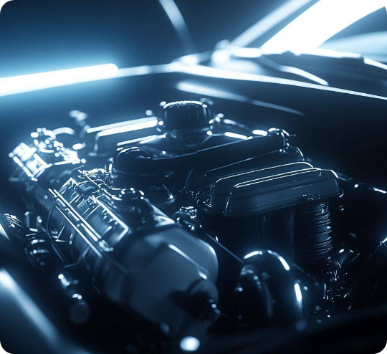
FEATURE PRIORITIZATION
Top Drivers identified through correlation analysis:
Engine Power (kW)Strongest
Vehicle Mass (kg)High

Slide 9


EXPLORATORY ANALYSIS
MASS CORRELATION
POWER INFLUENCE
FUEL VARIANCE
Efficiency drops exponentially as vehicle mass exceeds 1600kg.
Optimal efficiency found in the 70kW - 110kW output range.
Diesel cycles show higher average thermal efficiency in heavy vehicles.

Slide 10
PHASE II: ALGORITHM SELECTION
BENCHMARKING PERFORMANCE ACROSS MODELS

Slide 11

LINEAR BASELINES
Initial testing focused on linear and regularized models. While fast, they failed to capture automotive complexities.
•
Linear Regression R²: 0.54
•
Ridge/Lasso R²: 0.54
•
Support Vector Regressor R²: 0.53

Slide 12


TREE-BASED EVOLUTION
Transitioning to tree architectures allowed the model to split decisions based on specific engine thresholds.
•
Decision Tree R²: 0.88
•
KNN (k=9) R²: 0.90
Significantly reduced MAE in high-performance segments.

Slide 13
ENSEMBLE EXCELLENCE
Combining multiple weak learners yielded the highest performance metrics:
XGBoost Regressor 91% Accuracy
Random Forest Regressor 96% Accuracy

Slide 14

THE WINNER: RANDOM FOREST
Random Forest was selected for production due to its exceptional R² score and variance handling.
96%
•
n_estimators: 200
•
R-Squared Score
max_depth: 20
•
Criterion: Squared Error

Slide 15


MODEL STABILITY
GENERALIZATION
RELIABILITY
The model shows zero bias across diverse vehicle classes, from city hatchbacks to performance sedans.
Validation on unseen test data confirms the model’s robustness against overfitting.

Slide 16
PHASE III: VALIDATION & DEPLOYMENT
MEASURING PREDICTIONS AGAINST REALITY

Slide 17
PERFORMANCE BENCHMARKS
Metric | Linear Baseline | Winning RF Model
R² Score | 0.54 | 0.96
Mean Abs Error | 3.8 km/L | 0.35 km/L

Slide 18
REAL VS. PREDICTED
Vehicle Model | Real Mileage (km/L) | Predicted (km/L) | Accuracy
Maruti Swift | 22.00 | 19.71 | 89.6%
Honda City | 17.80 | 18.52 | 95.9%
Honda Civic | 16.50 | 16.59 | 99.5%
Toyota Corolla | 16.00 | 17.07 | 93.3%
VW Polo | 18.20 | 18.52 | 98.2%

Slide 19

OPEN SOURCE REPOSITORY
https://github.com/mohanraj-Ai/FUEL-EFFICIENCY-PREDICTOR

